Slide 1

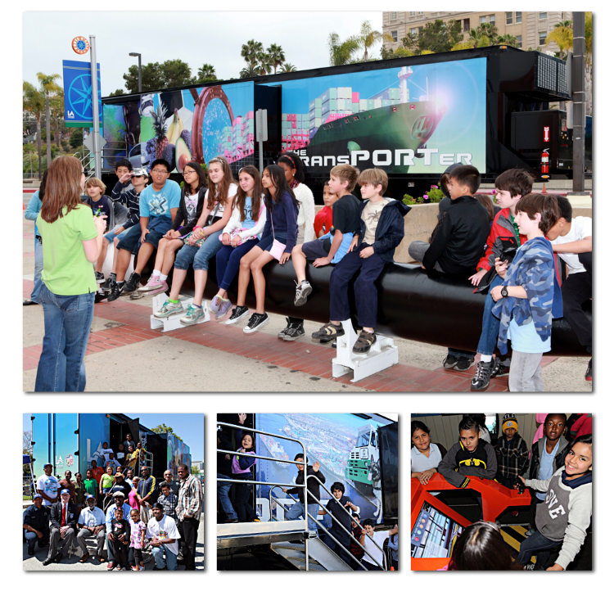
Port of
Los Angeles
TransPORTer
Miscellaneous

